Slide 1
Spark on HDInsight Overview
Ali Zaidi
Data Scientist
AI and Research

Slide 2
Introduction
Class hours
8:00 A.M. to 5:00 P.M.
Restrooms
Meals
10:00 A.M. – Break
Noon – Lunch
3:00 P.M. – Break
Internet connectivity

Slide 3
Agenda – Apache Spark
Day 1
Time | Title
8:00 - 8:30 | Welcome and overview
8:30 - 9:30 | Apache Spark overview
9:30 - 9:45 | Break
9:45 - 11:00 | Working with Resilient Distributed Datasets (RDDs)
11:00 - 11:45 | Working with notebooks on Apache Spark
11:45 - 12:45 | Lunch
12:45 - 2:15 | Spark SQL overview
2:15 - 3:00 | Running interactive Spark SQL queries with Jupyter and Zeppelin notebooks
3:00 - 3:15 | Break
3:15 - 4:00 | Working with Apache Hive and Microsoft Power BI in Apache Spark
4:00 - 4:15 | Day One wrap-up

Slide 4
Agenda – Apache Spark
Day 2
Time | Title
8:00 - 8:15 | Welcome back
8:15 - 9:15 | Spark Streaming overview
9:15 - 10:00 | Spark Streaming with Event Hubs and Scala applications
10:00 - 10:15 | Break
10:15 - 11:00 | Machine learning with Spark MLlib
11:00 - 11:45 | Building applications with Spark MLlib
11:45 - 12:30 | Apache Spark in Azure HDInsight
12:30 - 12:45 | R Server on HDInsight with Apache Spark
12:45 - 1:00 | Day Two and final wrap-up

Slide 5

© 2016 Microsoft Corporation. All rights reserved. Microsoft, Windows, Windows Vista and other product names are or may be registered trademarks and/or trademarks in the U.S. and/or other countries.
The information herein is for informational purposes only and represents the current view of Microsoft Corporation as of the date of this presentation. Because Microsoft must respond to changing market conditions, it should not be interpreted to be a commitment on the part of Microsoft, and Microsoft cannot guarantee the accuracy of any information provided after the date of this presentation. MICROSOFT MAKES NO WARRANTIES, EXPRESS, IMPLIED OR STATUTORY, AS TO THE INFORMATION IN THIS PRESENTATION.

Slide 6
Towards a Faster Distributed Processing Framework

Slide 7

Learning objectives
General Purpose Distributed Data Processing Systems
Spark on HDInsight
Performance and Architecture
Use Cases

Slide 8
General-Purpose Distributed Data Processing Engines

Slide 9

MapReduce
MapReduce
Mapper
Mapper
Mapper
Advantages
Simple framework for distributed computation
All computation must be expressed as a series of steps defined by two simple operations:
Mappers – input/sources for data
Reducers – writes/sinks for data
Complete framework for batch jobs that can be expressed as a simple data flow
Resiliency and fault-tolerance are driven by the nature of the acyclic dataflow graph:
Each map-reduce round is independent of the other, and can be rebuilt if lost
Communication is handled entirely through the edges in the dataflow graph
Reducer
Reducer
Mapper
Mapper
HDFS
Reducer
Mapper
Mapper
HDFS
Reducer
HDFS
Mapper
Mapper
Reducer
Notes:
Objective: This slide introduces the types and uses of RDDs.
Talking points:
The primary abstraction is Spark, a fault-tolerant collection of elements stored in-memory or on-disk that can be operated on in parallel.
Two types:
Parallelized collection: apply a parallel transformation to an existing Scala collection; users must specify the number of partitions.
Hadoop data set: run functions on each record of a file in HDFS or any other storage system supported by Hadoop.
Can be persisted in-memory across operations. When an RDD is persisted, each node stores any partitions of it that it computes in-memory and then reuses them in other actions on the data set.
Can mark an RDD as persistent just by calling the persist() or cache() method.
Can specify the storage level: on-disk or in-memory as a serialized Java object.
Cached or persistent RDDs are fault tolerant without replication.
Each RDD maintains its lineage (example: the sequence of transformations that resulted in the RDD).
If an RDD is lost because a node crashed, it can be reconstructed by replaying the sequence of operations.

Slide 10

MapReduce
Tez
Disadvantages
Each reduce step requires writing back to disk
For iterative jobs, such as machine learning models, a MapReduce implementation might have multiple reducers
No global considerations to optimize the dataflow graph
Proposed Improvements
Stinger/Tez
Dryad
Naiad:
Cyclical differential dataflow model
Apache Spark
Mapper
Mapper
Mapper
Mapper
Mapper
Reducer
Reducer
Reducer
Reducer
Reducer
Notes:
Objective: This slide introduces the types and uses of RDDs.
Talking points:
The primary abstraction is Spark, a fault-tolerant collection of elements stored in-memory or on-disk that can be operated on in parallel.
Two types:
Parallelized collection: apply a parallel transformation to an existing Scala collection; users must specify the number of partitions.
Hadoop data set: run functions on each record of a file in HDFS or any other storage system supported by Hadoop.
Can be persisted in-memory across operations. When an RDD is persisted, each node stores any partitions of it that it computes in-memory and then reuses them in other actions on the data set.
Can mark an RDD as persistent just by calling the persist() or cache() method.
Can specify the storage level: on-disk or in-memory as a serialized Java object.
Cached or persistent RDDs are fault tolerant without replication.
Each RDD maintains its lineage (example: the sequence of transformations that resulted in the RDD).
If an RDD is lost because a node crashed, it can be reconstructed by replaying the sequence of operations.

Slide 11
Coordinating Data Flow for Job Execution
Facilitating Data Flows
The primary reason why Hadoop gained such dramatic traction in the data processing and warehousing ecosystem is that it provided a universal framework for writing and executing distributed jobs
However, a single MapReduce (Hive, Pig, etc) is rarely sufficient for most use-cases
Instead – need to coordinate a series of MapReduce jobs
The primary engineering effort is spent in coordinating a data flow for job execution
Can we do better than MapReduce, which recreates daemons/readers and writes to disk for each iteration in the data flow??

Slide 12
#x
In
@y
⋈
max
⋈
z?
⋈
Notes:
https://www.youtube.com/watch?v=6pF7sk2sfk0
https://www.youtube.com/watch?v=yyhMI9r0A9E&t=5s
Distributing processing systems tightly coupled with the underlying system
Timely dataflow
Iterative graph model
Extract user name mentions form edges of graph
Okay for static, some ETL, some batch processing
Derive graph from stream of twitter messages
Need to gdo it sliding windows
Extract user name mentions
Okay for static graphs
Need to update in real-time
Add it with interactive queries
Query might be a username
Find most popular hashtag for that user
Need to minimze the latency of the coordination

Slide 13
Real-time
StreamInsight
Storm
Batch
SCOPE
DryadLINQ
Vowpal Wabbit
Graph
GraphLab
Giraph
Naiad

Slide 14
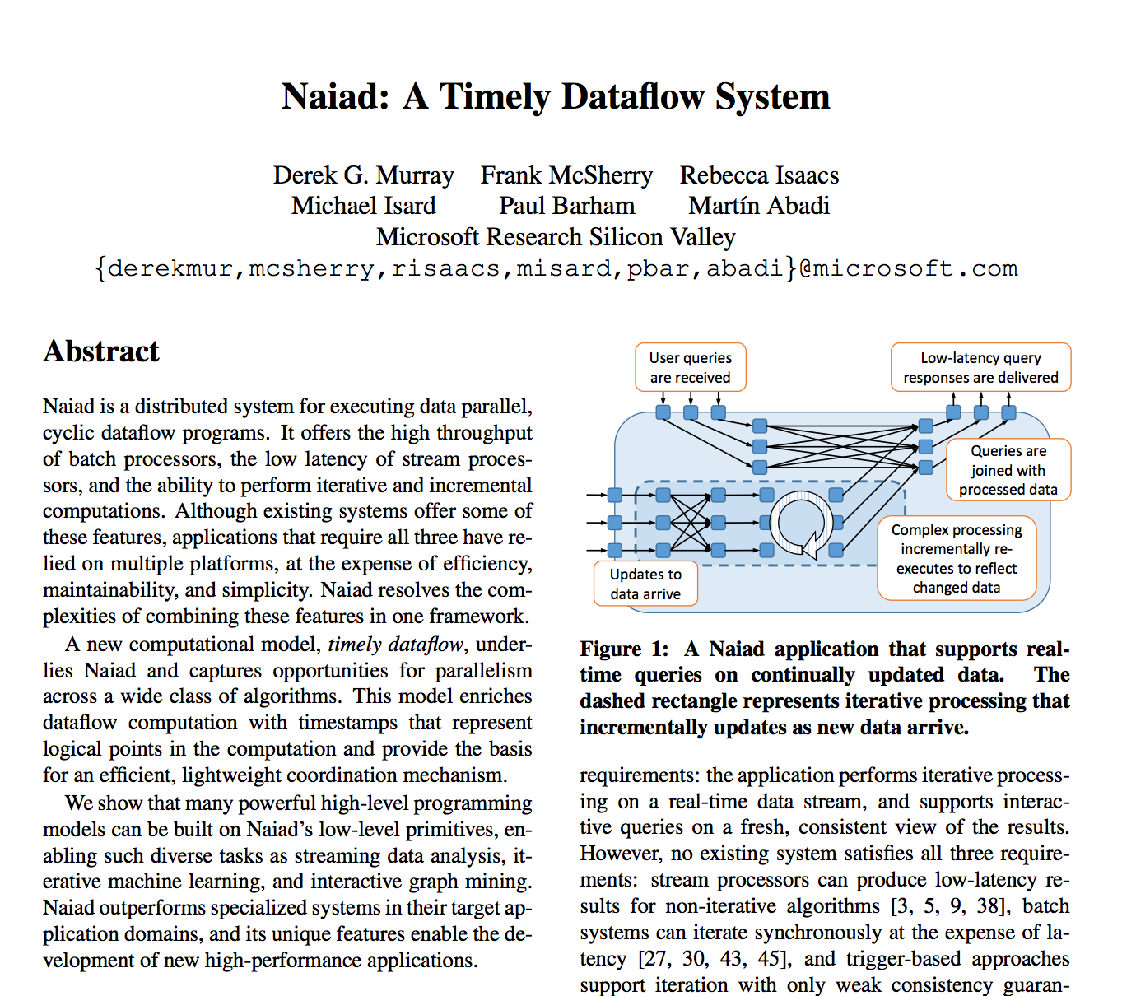

Slide 15
While Naiad and Dryad are no longer actively developed as their own projects
… they directly influenced the creation of another project….

Slide 16
Apache Spark - A unified framework

Slide 17

A unified, open source, parallel data processing framework for big data analytics
Directly inspired by the cyclical data flow model of Naiad and Dryad’s DAG data flow model, as well as DryadLINQ’s programming API
Started as a research project at the AMPLab at UC Berkeley in 2009
Open Source License (Apache 2.0)
Latest Stable Release: v2.2.0 (July 2017)
Most actively developed Apache project (1,000+ developers)
“Fast and expressive cluster computing system” – Matei Zaharia, creator of Apache Spark
Notes:
Objective: Apache Spark unifies batch processing, real-time processing, stream analytics, machine learning, and interactive SQL.
Talking points:
Apache Spark is an open source processing framework that runs large-scale data analytics applications. Built on an in-memory compute engine, Spark is known for high performance querying on big data. It leverages a parallel data processing framework that persists data in-memory and disk if needed. This allows Spark to deliver both 100x faster speed and a common execution model to various tasks like extract, transform, load (ETL), batch, interactive queries on data in Hadoop distributed file system (HDFS).
General capabilities of Spark include:
One execution model for multiple tasks: Apache Spark leverages a common execution model for doing multiple tasks like ETL, batch queries, interactive queries, real-time streaming, machine learning, and graph processing on data stored in Azure Storage.
In-memory processing for interactive scenarios: Apache Spark persists data in-memory and disk if needed to achieve up to 100x faster queries while processing large datasets in Hadoop. This makes Spark for Azure HDInsight ideal to speed up intensive big data applications.
Developer friendly: Spark supports a variety of development languages like Java, Python, and Scala APIs to ease development. You can write sophisticated parallel applications with a collection of over 80 operators, allowing developers to rapidly iterate over data.
Apache Spark comprises four aspects for the purposes of big data analytics:
Spark SQL – interactive queries
Spark Streaming – stream processing
SparkMLlib – machine learning
GraphX – graph computation

Slide 18
Apache Spark: A unified framework
A unified, open source, parallel data processing framework for big data analytics
Spark SQL
Interactive queries
Spark Streaming
Stream processing
Spark MLlib
Machine learning
GraphX
Graph computation
Spark core engine
YARN
Mesos
Standalone scheduler
HDFS
Azure Blob Storage/Data Lake Store
Notes:
Objective: Apache Spark unifies batch processing, real-time processing, stream analytics, machine learning, and interactive SQL.
Talking points:
Apache Spark is an open source processing framework that runs large-scale data analytics applications. Built on an in-memory compute engine, Spark is known for high performance querying on big data. It leverages a parallel data processing framework that persists data in-memory and disk if needed. This allows Spark to deliver both 100x faster speed and a common execution model to various tasks like extract, transform, load (ETL), batch, interactive queries on data in Hadoop distributed file system (HDFS).
General capabilities of Spark include:
One execution model for multiple tasks: Apache Spark leverages a common execution model for doing multiple tasks like ETL, batch queries, interactive queries, real-time streaming, machine learning, and graph processing on data stored in Azure Storage.
In-memory processing for interactive scenarios: Apache Spark persists data in-memory and disk if needed to achieve up to 100x faster queries while processing large datasets in Hadoop. This makes Spark for Azure HDInsight ideal to speed up intensive big data applications.
Developer friendly: Spark supports a variety of development languages like Java, Python, and Scala APIs to ease development. You can write sophisticated parallel applications with a collection of over 80 operators, allowing developers to rapidly iterate over data.
Apache Spark comprises four aspects for the purposes of big data analytics:
Spark SQL – interactive queries
Spark Streaming – stream processing
SparkMLlib – machine learning
GraphX – graph computation

Slide 19
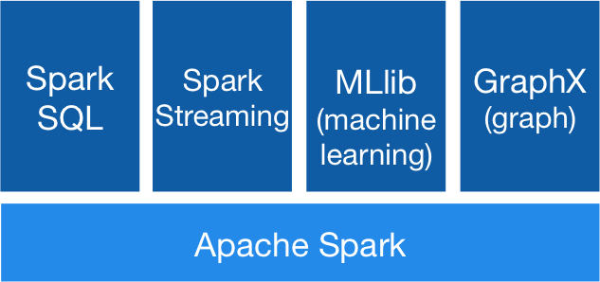

Apache Spark: A unified framework
Spark Unifies:
Batch Processing
Real-time processing
Stream Analytics
Machine Learning
Interactive SQL
Goal: unified engine across datasources, workloads, and environments
Simplified Developer APIs: Scala, Java, Python, R

Slide 20
How Many API’s in Spark?
Unstructured API
Structured API
Manipulating Raw Java Objects
RDDs
Accumulators
Broadcast Variables
Optimized for Tables
DataFrames
DataSets
Spark SQL

Slide 21

What makes Spark fast?
(Updated) Latency Numbers Every Programmer Should Know (Norvig, Dean, Hellerstein, Meijer)
Read 1MB sequentially from disk | 1ms ≅ 1,000,000 ns
Read 1 MB sequentially from SSD | 98,000 ns (10x)
Read 1 MB sequentially from memory | 6,000 ns (200x)
Transfer one packet (64KB) from California -> Netherlands | 150 ms (0.006x)
Transfer one packet within same datacenter | 500,000 ns
In-memory data sharing between steps of a job
Reads from HDFS
Writes to HDFS
Reads from HDFS
Writes to HDFS
In traditional MapReduce
Step 1
Step 2
Reads and writes
from HDFS
In Spark
Step 1
Cache
In-Memory
Step 2
Notes:
Objective: This slide describes the architecture of how Apache Spark is different, allowing it to offer better performance for data sharing.
Table Source: https://gist.github.com/jboner/2841832
Talking points:
Spark provides primitives for in-memory cluster computing. A Spark job can load and cache data into memory and query it repeatedly, much more quickly than disk-based systems.
Spark integrates into the Scala programming language to let you manipulate distributed data sets like local collections. No need to structure everything as map and reduce operations.
Data sharing between operations is faster, since data is in-memory.
Hadoop shares data through HDFS, an expensive option. It also maintains three replicas.
Spark stores data in-memory without any replication
References:
https://people.eecs.berkeley.edu/~rcs/research/interactive_latency.html
https://gist.github.com/jboner/2841832

Slide 22
Spark – Data Processing with DAGs
More Complex Dataflow Primitives
Unlike MapReduce, Spark’s data processing engine is not limited to mappers and reducers
Single Spark jobs can have multiple stages, each compromising of many tasks (“mappers” and “reducers”)
Data is cached and reused across iterations, thereby reducing disk I/O
Built as a general-processing engine for multiple workloads
Notes:
Objective: This slide introduces the types and uses of RDDs.
Talking points:
The primary abstraction is Spark, a fault-tolerant collection of elements stored in-memory or on-disk that can be operated on in parallel.
Two types:
Parallelized collection: apply a parallel transformation to an existing Scala collection; users must specify the number of partitions.
Hadoop data set: run functions on each record of a file in HDFS or any other storage system supported by Hadoop.
Can be persisted in-memory across operations. When an RDD is persisted, each node stores any partitions of it that it computes in-memory and then reuses them in other actions on the data set.
Can mark an RDD as persistent just by calling the persist() or cache() method.
Can specify the storage level: on-disk or in-memory as a serialized Java object.
Cached or persistent RDDs are fault tolerant without replication.
Each RDD maintains its lineage (example: the sequence of transformations that resulted in the RDD).
If an RDD is lost because a node crashed, it can be reconstructed by replaying the sequence of operations.

Slide 23
Spark on Azure HDInsight

Slide 24
Learning objectives
Provisioning HDInsight Spark clusters
Resource Manager
A summary of notebooks
Spark Shell and standalone Scala programs
HDInsight integration with Azure Event Hubs

Slide 25
Spark on Azure HDInsight
Fully Managed Service
100% open source Apache Spark and Hadoop bits
Latest releases of Spark (currently 1.6.2 and 2.0.1, 2.1.0 in preview)
Fully supported by Microsoft and Hortonworks
99.9% Azure Cloud SLA
Certifications: PCI, ISO 27018, SOC, HIPAA, EU-MC
Optimized for data exploration, experimentation and development
Jupyter Notebooks (scala, python, automatic data visualizations)
IntelliJ and Eclipse plugins (job submission, remote debugging)
Livy sessions for remote submission
ODBC connector for Power BI, Tableau, Qlik, SAP, Excel, etc

Slide 26

Integrated with Azure data pipelines
Batch pipelines
Azure Data Factory orchestrates Spark ETL jobs
PowerBI connector for Spark
HA of job submission service
Streaming pipelines
High Availability for Spark Streaming using Yarn
Azure connectors: EventHub, Power BI, Azure SQL, DW, Data Lake
Github: https://github.com/hdinsight/spark-powerbi-connector
Blog: https://blogs.msdn.microsoft.com/azuredatalake/2016/03/09/ saving-spark-dataframe-to-powerbi/

Slide 27
Provisioning HDInsight Spark clusters

Slide 28
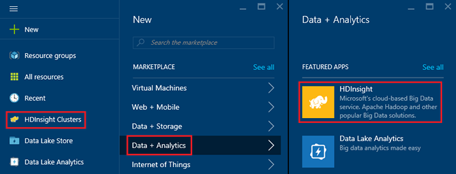
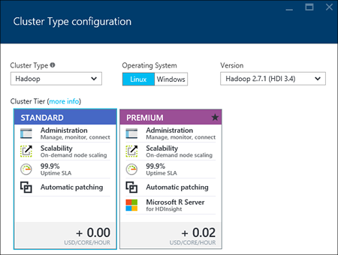
Creating an HDInsight Spark cluster
The Azure console lists all types of HDInsight clusters (HBase, Storm, and Spark) currently provisioned.
Notes:
Objective: This slide shows you how to create an HDInsight Spark cluster and understand the parameters.
Talking points:
Provision a Spark cluster directly from the Azure console.
The number of data nodes are all that have to be specified (but can be changed later).
Clusters can have up to sixteen nodes.
More nodes enable more queries to run concurrently.

Slide 29
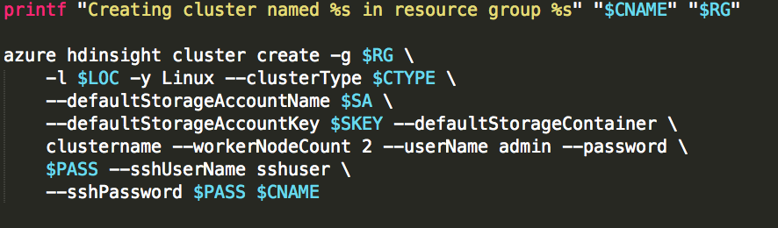
Automated Deployments
https://github.com/azure/learnanalytics-hdi-hero

Slide 30
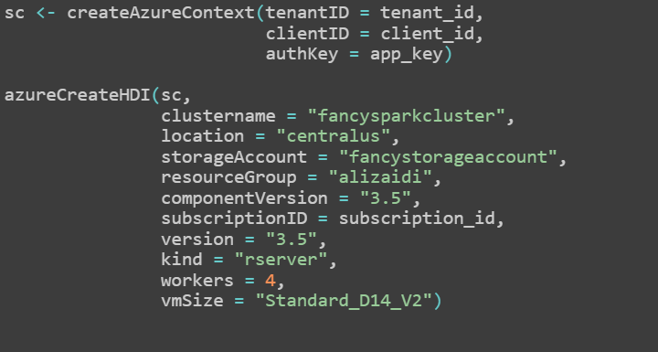
Provisioning Clusters with the AzureSMR
http://github.com/Microsoft/AzureSMR

Slide 31
Ambari Dashboard
The Ambari Dashboard provides links to access:
Ambari web UI – monitors Spark clusters
Hosts (Resource Manager) – controls amount of resources allocated to various Spark cluster components
Notebooks – interactive web- based tools to develop and run Spark programs
Notes:
Objective: This slide gives a brief summary of the Ambari Dashboard.
Talking points:
In the HDInsight Spark Dashboard, you can find three links to access: Ambari Web UI, Hosts (Resource Manager), and Notebooks:
Ambari web UI – Web-based UI that monitors Spark clusters
Resource Manager – Where you can control the resources and how they are allocated to various Spark cluster components
Notebooks – Interactive web-based tools, such as Zeppelin or Jupyter, that develop and run Spark programs

Slide 32
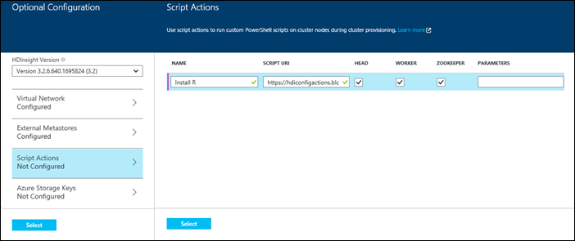
Creating HDInsight Spark with Script Actions
Install Spark on an HDInsight cluster using Script Actions with the wizard.
Obtain a default script at: https://hdiconfigactions.blob.core.windows.net/sparkconfigactionv03/spark-installer-v03.ps1
By default, the script installs:
Spark 1.2.0 on HDInsight 3.2 clusters.
Spark 1.0.2 on HDInsight 3.1 clusters.
Spark requires no additional parameters
Notes:
Objective: This slide explores an alternative method of installing Spark on an HDInsight cluster by utilizing Script Actions.
Talking point:
Script Actions are a generic mechanism for installing custom software as HDInsight clusters are being provisioned.

Slide 33
Resource Manager

Slide 34
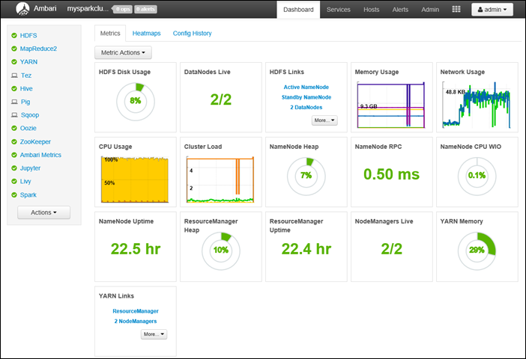
Ambari Web UI
Notes:
Objective: This slide gives a brief summary of the Ambari Services.
Talking points:
The web UI enables you to have a dashboard view and control of the number of cores and amount of memory allocated to Spark cluster components and notebooks.
Ambari makes Hadoop management simpler by providing an easy-to-use web UI that can be used to provision, manage, and monitor Hadoop clusters. Developers can integrate these capabilities into their applications by using the Ambari REST APIs.

Slide 35
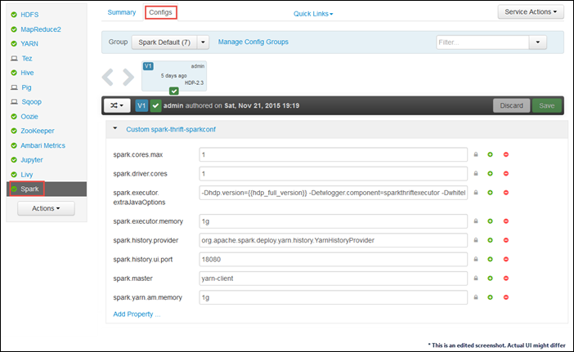
Resizing a Spark cluster
Notes:
Objective: This slide discusses resizing an HDInsight Spark cluster.
Talking points:
Like other HDInsight cluster types, the number of nodes in a Spark cluster can be increased dynamically.
The cluster or the running jobs do not have to be paused or stopped to resize.
Caching data in-memory or SSD can improve query performance.

Slide 36
Summary of notebooks

Slide 37

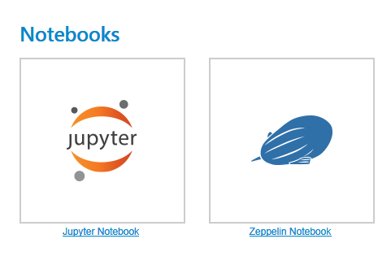
Notebooks: Jupyter and Zeppelin
Notes:
Objective: This slide discusses the two notebooks HDInsight Spark supports: Jupyter and Zeppelin.
Talking points:
Links to notebooks are available on the dashboard.
Pre-installed notebooks can be launched by clicking on the links. No other setup is required (such as launching background services). HDInsight Spark starts the Jupyter kernels or the Zeppelin servers.
The notebooks are part of a subscription and persistent across clusters.

Slide 38
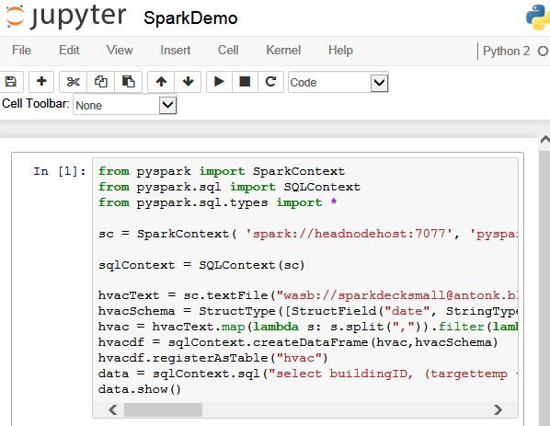
HDInsight Spark: Jupyter notebooks
A Jupyter notebook showing a Spark program in Python 2
Notes:
Objective: This slide shows how to develop and run the Jupyter notebook through HDInsight Spark.
Talking points:
Select a particular cell and execute it by either pressing Shift+Enter or clicking the play icon. It is possible to select all cells to run as well. To stop the execution, click the stop icon.
Interrupt, restart, or reconnect to a running kernel.
Connect to a different kernel (however, only Python kernels are currently available).
Duplicate or rename notebooks.
While editing, save and checkpoint the changes and revert to a checkpoint.
On the main Jupyter console page, read the list of running notebooks.

Slide 39
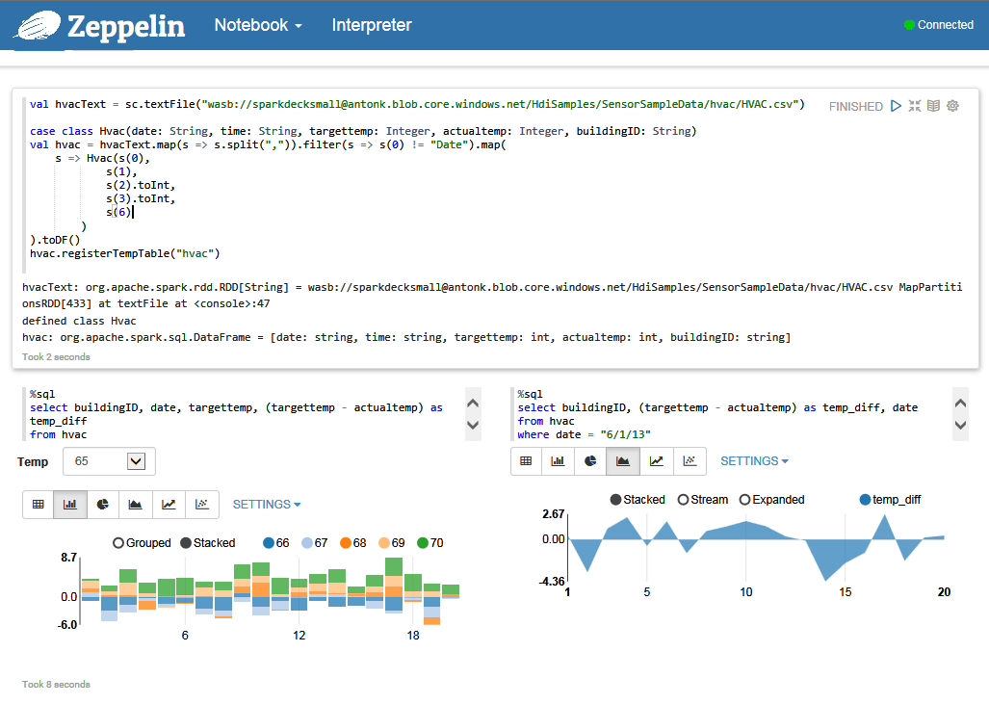
HDInsight Spark: Zeppelin notebooks
Notes:
Objective: How to develop and run the Zeppelin notebook through HDInsight Spark.
Talking points:
Zeppelin notebook must be connected to a Spark cluster in order to run.
To execute a notebook paragraph, click the play icon in the upper right hand corner.
Like Jupyter, Zeppelin makes it possible to include interactive charts and graphs in a notebook.
Control the visualization using the Settings drop-down menu.
HDInsight includes a number of charts and graphs that are built into the Zeppelin notebook.

Slide 40
Spark Shell and standalone programs

Slide 41
Interactive queries with Spark Shell
From Azure Portal, enable Remote Desktop Protocol (RDP)
From RDP, open Hadoop command line and start Spark Shell
On Scala prompt, enter Spark query below:
val file = sc.textFile("/example/data/gutenberg/davinci.txt")
val counts = file.flatMap(line => line.split(" ")).map(word => (word, 1)).reduceByKey(_ + _) counts.toArray().foreach(println)
Notes:
Objective: This slide discusses using interactive queries with Spark Shell.
Talking points:
From the Azure portal, enable Remote Desktop for the cluster you created with Spark installed, and then remote into the cluster.
In the Remote Desktop Protocol (RDP) session, from the desktop, open the Hadoop command line and start the Spark shell .\bin\spark-shell master yarn.
Once the command finishes running, the Scala prompt scala> should appear:
On the Scala prompt, enter the Spark query shown below. This query counts the occurrence of each word in the davinci.txt file that is available at the /example/data/gutenberg/ location on the Azure Blob storage, which is associated with the cluster.
The output should appear on the console.
Type :q to quit the Scala session.

Slide 42

Machine learning with Anaconda
Free
Enterprise-ready
Python distribution tool, offering:
Large-scale data processing
Predictive analytics
Scientific computing
Notes:
Objective: This slide introduces Anaconda and how it integrates with HDInsight Spark.
Talking points:
Anaconda is a free, enterprise-ready Python distribution tool for large-scale data processing, predictive analytics, and scientific computing.
It includes 330+ of the most popular Python packages for science, math, engineering, and data analysis.
Anaconda is installed as part of HDInsight Spark. The libraries are updated at a regular cadence.

Slide 43
Standalone scale programs
Write a Scala program that defines a MyTestApp object
Save the object in MyTestApp.scala
Build the program with Simple Build Tool (sbt) or remote to the Spark cluster
Notes:
Objective: This slide defines available Scala standalone scale programs
Talking points:
Build the program with Simple Build Tool (sbt):
Install SBT from http://www.scala-sbt.org/
Copy MyTestApp.scala to MyTestApp\src\main\scala
Navigate to MyTestApp\src\main\scala
Run from the sbt package command prompt
On completion, mytestapp_2.10-1.0.jar file is created in MyTestApp\Target\
Remote to the Spark cluster:
Copy mytestapp_2.10-1.0.jar file over
Run from command prompt: c:\apps\dist\spark-1.2.0\bin\spark-submit –class “MyTestApp” –master local mytestapp_2.10-1.0.jar
The results should be displayed on the console

Slide 44
Running and managing queries/jobs
1
2
Use REST APIs to manage jobs
Run concurrent queries against the same Spark cluster
Notes:
Objective: This slide discusses running and managing queries to manage jobs.
Talking points:
<<animation on click>>
Use REST APIs to manage jobs:
Submit Spark Jobs
Cancel Spark Jobs
Get Job Status
<<animation on click>>
Run concurrent queries against the same Spark cluster:
Run concurrent queries from a single app or multiple apps.
A blocking call from one query should not impact other queries.
The number of supported concurrent queries depends on the cluster size. On average HDInsight Spark will support one query per node (for example, 8 nodes will support 8 concurrent queries).

Slide 45
HDInsight integration with Azure Event Hubs

Slide 46





Streaming with Azure Event Hub
Azure Event Hub
HDInsight Spark Streaming
Power BI
Notes:
Objective: This slide shows how HDInsight uses Spark Streaming to integrate with Azure Events.
Talking points:
HDInsight Spark Streaming offers direct integration, out-of-the-box, with Azure Events.
HDInsight Spark Streaming allows you to author applications using Zeppelin notebooks or other IDEs.
Azure saves the Event Hub watermark and makes it possible for you to resume a streaming job from where you left it.
Azure allows you to direct the streaming output to Microsoft Power BI.

Slide 47
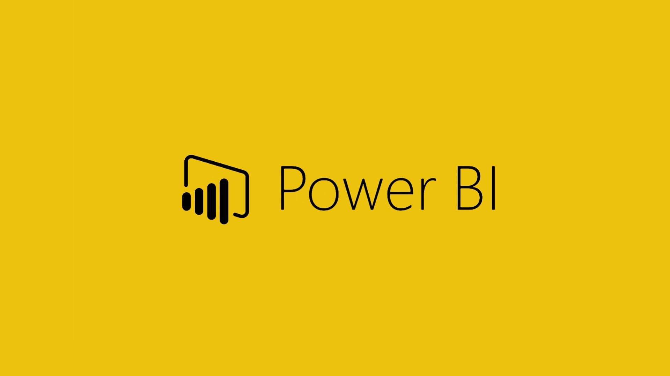

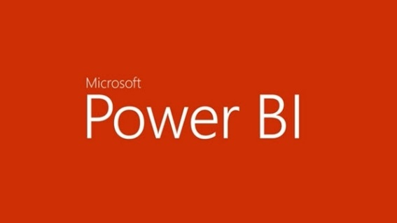


Integration with BI reporting tools
HDInsight Spark integrates with these BI tools to report on Spark data:
Notes:
Objective: This slide describes how HDInsight Spark integrates with business intelligence tools to report on data.
Talking points:
Report your data visually or integrate it with well-known business intelligence tools, such as Microsoft Power BI, Tableau, QlikView, and SAP Lumira.

Slide 48
Demo
Resource Manager
Notes:
Sources:
Microsoft Azure – Manage resources for the Apache Spark cluster in Azure HDInsight: How do I launch the Spark History Server?
https://azure.microsoft.com/en-us/documentation/articles/hdinsight-apache-spark-resource-manager/
Microsoft Azure – Manage resources for the Apache Spark cluster in Azure HDInsight: How do I launch the Yarn UI?
https://azure.microsoft.com/en-us/documentation/articles/hdinsight-apache-spark-resource-manager/
Microsoft Azure – Create Apache Spark cluster on Azure HDInsight (Linux) and run interactive queries using Spark SQL
https://azure.microsoft.com/en-us/documentation/articles/hdinsight-apache-spark-jupyter-spark-sql/
Microsoft Azure - Create a standalone Scala application and to run on HDInsight Spark cluster (Linux)
https://azure.microsoft.com/en-us/documentation/articles/hdinsight-apache-spark-create-standalone-application/

Slide 49
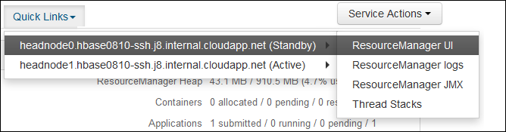
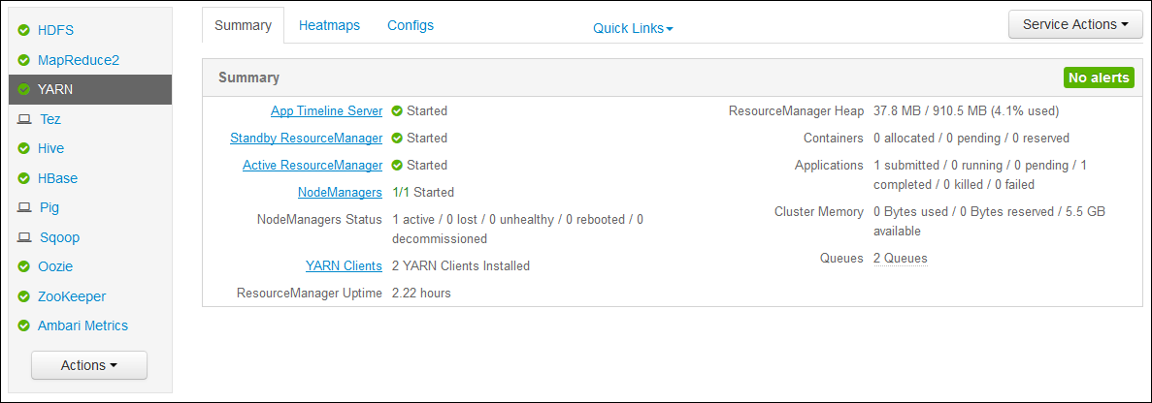
Notes:
Objective: This slide offers a demo for the Ambari as a Resource Manager.
Talking point:
Apache Ambari simplifies the management and monitoring of a Hadoop cluster by providing an easy to use web UI and REST API.
Instructions:
Once the cluster has been established, use the following steps to verify that you can access service web UIs from the Ambari Web:
In your browser, go to https://CLUSTERNAME.azurehdinsight.net, where CLUSTERNAME is the name of your HDInsight cluster.
When prompted, enter the admin user name (admin) and password for your cluster. You may be prompted a second time by the Ambari web UI. If so, re-enter the information.
From the Ambari Web UI, select YARN from the list on the left of the page.
When the YARN service information is displayed, select Quick Links. A list of the cluster head nodes will appear. Select one of the head nodes, and then select ResourceManager UI.
This UI also provides you the Hive editor for running the Hive queries.

Slide 50
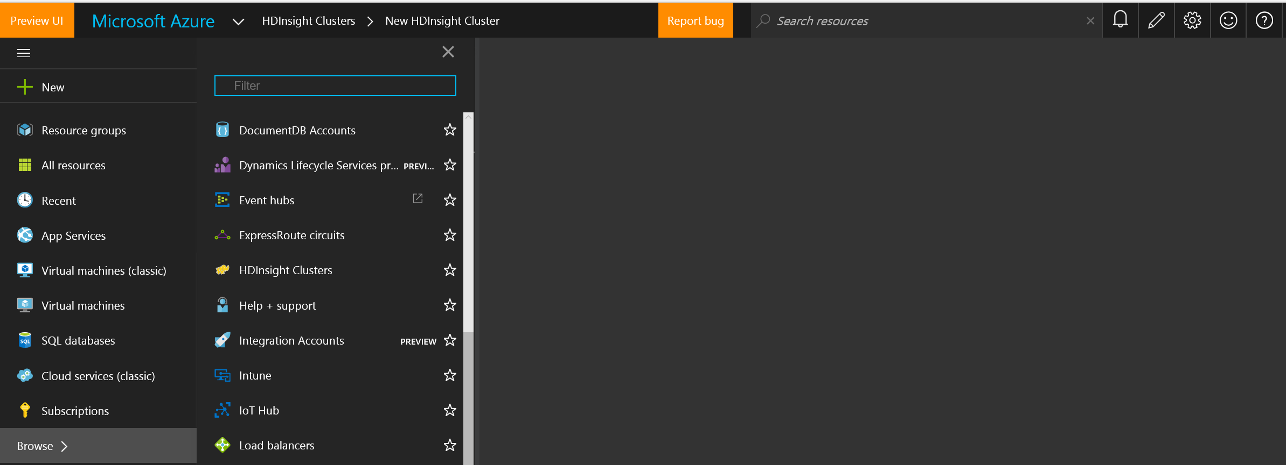
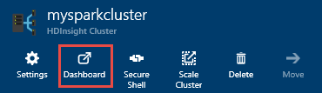
Notes:
Objective: This slide offers a demo for the Ambari as a Resource Manager.
Talking point:
Spark on Azure HDInsight provides the Ambari Web UI to manage the cluster resources and monitor the health of the cluster.
Instructions:
From the Azure Portal, from the startboard, click the tile for your Spark cluster (if you pinned it to the startboard). You can also navigate to your cluster under Browse All > HDInsight Clusters. <<animation on click>>
From the Spark cluster blade, click Dashboard. When prompted, enter the admin credentials for the Spark cluster. <<animation on click>>

Slide 51
© 2016 Microsoft Corporation. All rights reserved. Microsoft, Windows, Windows Vista and other product names are or may be registered trademarks and/or trademarks in the U.S. and/or other countries.
The information herein is for informational purposes only and represents the current view of Microsoft Corporation as of the date of this presentation. Because Microsoft must respond to changing market conditions, it should not be interpreted to be a commitment on the part of Microsoft, and Microsoft cannot guarantee the accuracy of any information provided after the date of this presentation. MICROSOFT MAKES NO WARRANTIES, EXPRESS, IMPLIED OR STATUTORY, AS TO THE INFORMATION IN THIS PRESENTATION.

Slide 52


Working with notebooks on Apache Spark
Working with Notebooks on Azure and Accessing Cluster Dashboards

Slide 53
Learning objectives
Notebooks overview
Zeppelin
Jupyter

Slide 54
Notebooks overview

Slide 55



Developing Spark apps with notebooks
Jupyter and Zeppelin are two notebooks that work with Apache Spark
Notes:
Objective: This slide defines the notebooks that interact when developing in Apache Spark.
Talking points:
Notebooks are:
Web-based, interactive servers for REPL, also known as Read-Evaluate-Print-Loop style programming.
Well-suited for prototyping, rapid development, exploration, discovery, and iterative development.
Designed to consist of code, data, visualization, comments, and notes.
Designed to enable collaboration among team members.

Slide 56
Jupyter

Slide 57
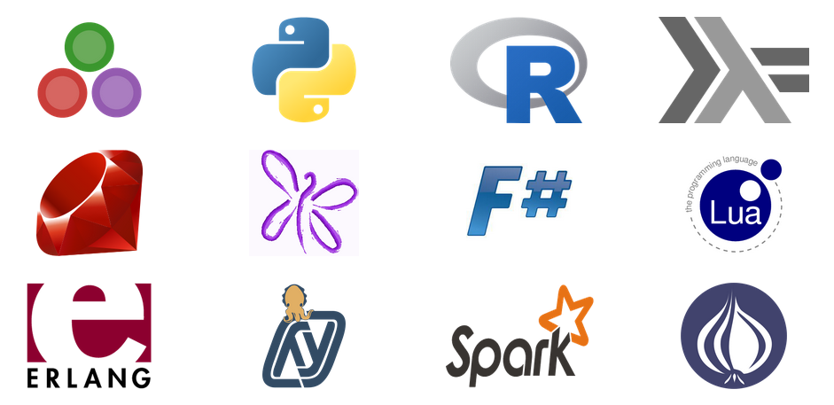
Jupyter
Language agnostic
Supports a rich Read-Evaluate-Print-Loop (REPL) protocol Includes:
Jupyter notebook document format (.ipynb)
Jupyter interactive web-based notebook
Jupyter Qt console
Jupyter Terminal console
Notebook viewer (nbviewer)
Notebook widgets
Supported languages (kernels)
See full list here
Notes:
Objective: This slide describes the process and architecture of the Zeppelin notebook in Apache Spark.
Talking points:
Its name is inspired by scientific and statistical languages (Julia, Python, and R).
Based on (and an evolution of) IPython. (Soon IPython will not ship separately.)
Is language agnostic. Languages are supported through kernels, a program that runs and introspects the users code.
Supports a rich REPL protocol.
Includes:
Jupyter notebook document format (.ipynb)
Jupyter Interactive web-based notebook
Jupyter Qt console
Jupyter Terminal console
Notebook viewer (nbviewer)

Slide 58
Zeppelin

Slide 59
Zeppelin architecture
Apache Spark is supported in Zeppelin with the Spark interpreter group, which consists of four interpreters.
Browser client
HTTP Rest Websocket
Zeppelin server
Class loader
Class loader
Name | Class | Description
%spark | SparkInterpreter | Creates SparkContext and provides scala environment
%pyspark | PySparkInterpreter | Provides python environment
%sql | SparkSQLInterpreter | Provides SQL environment
%dep | DepInterpreter | Dependency loader
Interpreter group
Interpreter group
Interpreter
Dep
…
Spark
Spark SQL
…
Maven
Spark
Zeppelin is not installed as part of default cluster. Additional steps required.
Notes:
Objective: This slide describes the process and architecture of Zeppelin notebooks in Apache Spark.
Talking points:
Zeppelin is an Apache project currently in incubation.
It provides built-in Apache Spark integration (no need to build a separate module, plugin, or library for it). Spark integration is a feature of Zeppelin, and provides:
Automatic SparkContext and SQLContext injection
Runtime jar dependency loading from local filesystem or maven repository
Job cancellation capabilities while displaying progress
It is based on an interpreter concept that enables any language/data-processing-backend to be plugged into Zeppelin. Current languages included in the Zeppelin interpreter are:
Scala (with Apache Spark)
Spark SQL
Markdown
Shell
Share the notebook URL among collaborators; Zeppelin can then broadcast any changes in real time
Zeppelin provides a URL to display only the results. It does not include a menu or buttons, which means you can easily embed it as an iframe inside of your website

Slide 60
Demo
Jupyter notebook
Notes:
Sources:
What’s Up with Spark – Jupyter and Zeppelin Notebooks (Channel 9)
https://channel9.msdn.com/Series/Azure-Data-Lake/Whats-up-with-Spark35-Jupyter-and-Zepplein-Notebooks
Microsoft Azure – Getting Started: Create Apache Spark cluster on Azure HDInsight (Linux) and run interactive queries using Spark SQL – Run Spark SQL queries using a Jupyter notebook
https://azure.microsoft.com/en-us/documentation/articles/hdinsight-apache-spark-jupyter-spark-sql/

Slide 61
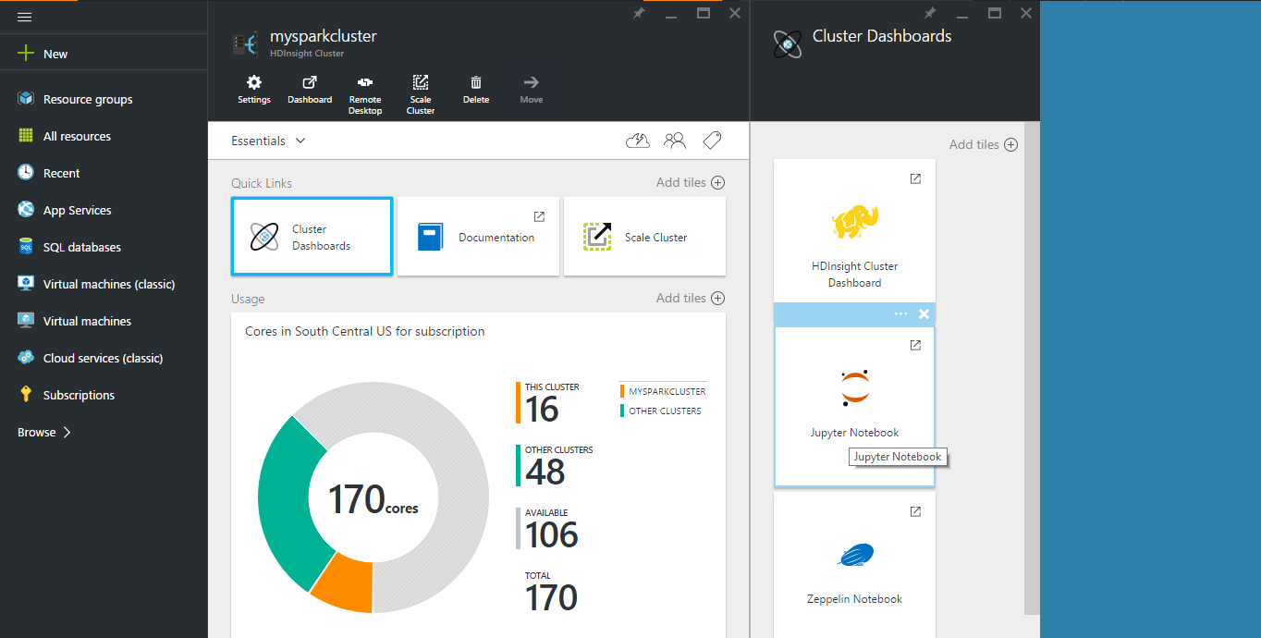
Notes:
Objective: This slide begins the Jupyter notebook demo.
Instructions:
In this demo, you will see how you can use a Jupyter notebook to run Spark SQL queries against a Spark cluster.
From the Azure Preview Portal on the startboard, click the tile for your Spark cluster (if you pinned it to the startboard). You can also navigate to your cluster under Browse All > HDInsight Clusters.
From the Spark cluster blade, you can navigate to the Cluster Dashboard blade from the Quick links, then click Jupyter Notebook. (If prompted, enter the admin credentials for the cluster.) You can also open the Jupyter notebook for your cluster by navigating to https://CLUSTERNAME.azurehdinsight.net/jupyter in your browser and replacing CLUSTERNAME with the name of your cluster.

Slide 62
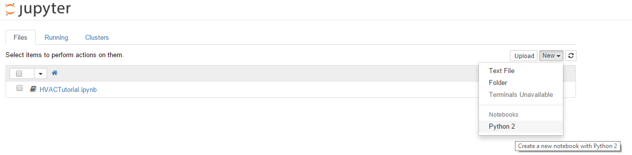
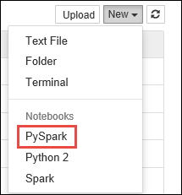
Notes:
Objective: This continues the Jupyter notebook demo.
Instructions:
You can create a new notebook of a text file or Python-supported notebook. In this UI, you can also see the running Jupyter processes, notebooks, and so on, as well as the status and progress of the IPython parallel computing clusters.

Slide 63
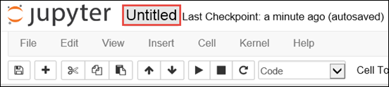
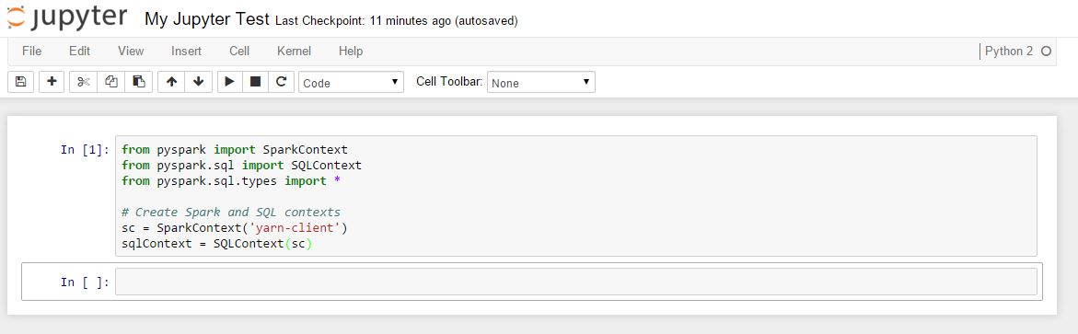
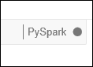
Notes:
Objective: This continues the Jupyter notebook demo.
Instructions:
Whenever a new notebook is created, it opens with the name Untitled.pynb. You can change the title by entering the appropriate name at the top of the page, in place of Untitled.
<<animation with click>> As shown in the code, first you need to import the required modules and create the SparkContext and SQLContext for the Jupyter notebook. To execute this code, press SHIFT + ENTER.
Every time you run a job in Jupyter, your web browser window title will show a (Busy) status along with the notebook title. You will also see a solid circle next to the Python 2 text in the top-right corner. After the job completes, this will change to a hollow circle.

Slide 64
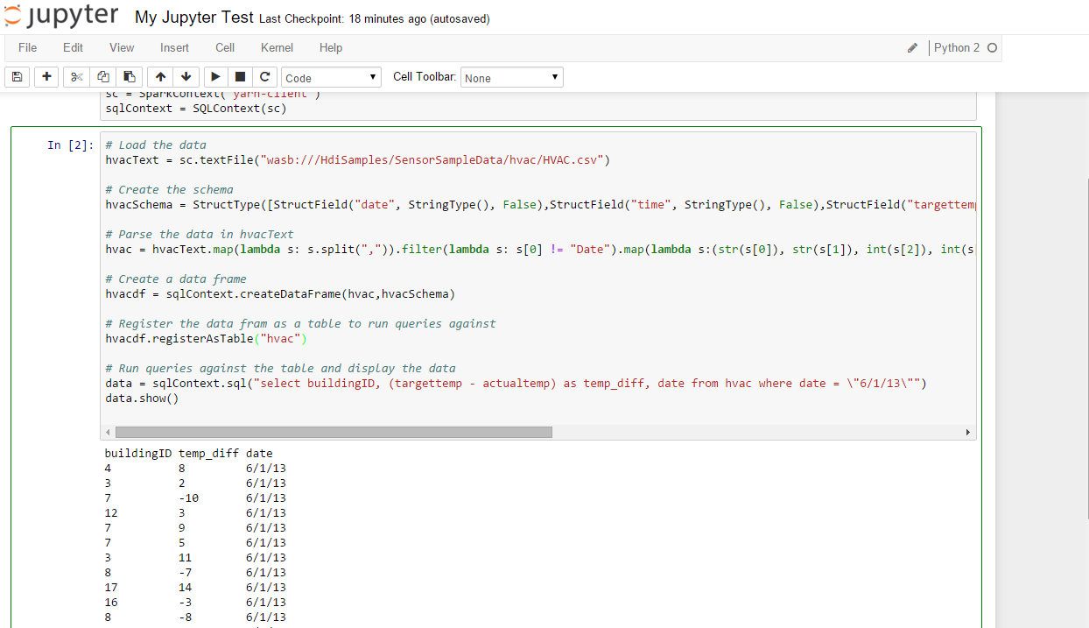
Notes:
Objective: This continues the Jupyter notebook demo.
Instructions:
Now we will load sample data of one of our sample files (hvac.csv) into a temporary table. When you create a Spark cluster in HDInsight, the sample data file, hvac.csv, is copied to the associated storage account under \HdiSamples\HdiSamples\SensorSampleData\hvac.
This code example registers the data into a temporary table with the name hvac.

Slide 65
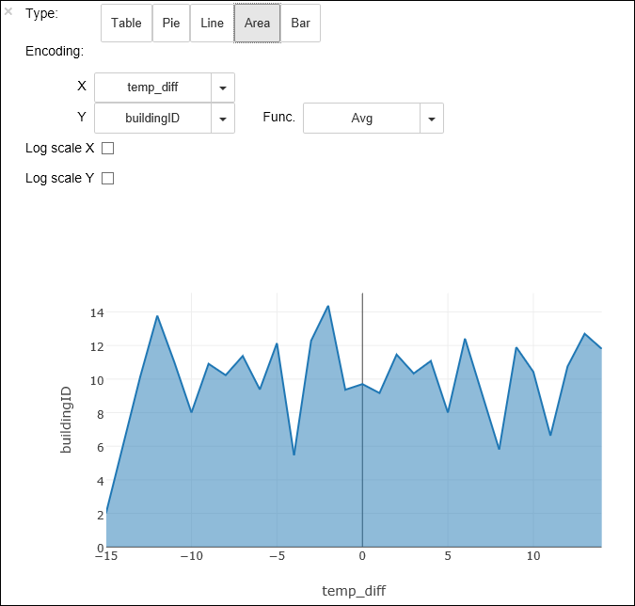
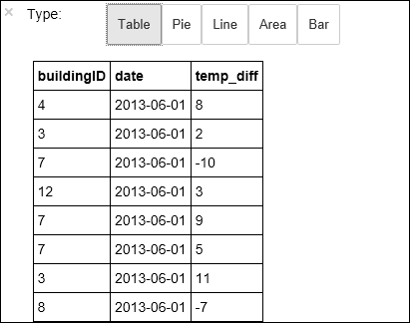
%%sql
SELECT buildingID, (targettemp - actualtemp) AS temp_diff, date FROM hvac WHERE date = \"6/1/13\"
Notes:
Objective: This continues the Jupyter notebook demo.
Instructions:
Because you are using a PySpark kernel, you can now directly run a SQL query on the temporary table hvac that you just created by using the %%sql magic. For more information about the %%sql magic, as well as other magics available with the PySpark kernel, see Kernels available on Jupyter notebooks with Spark HDInsight clusters. <<animation on click>>
Once the job is completed successfully, the following tabular output is displayed by default. <<animation on click>>
You can also see the results in other visualizations as well. For example, an area graph for the same output would look like the following. <<animation on click>>

Slide 66
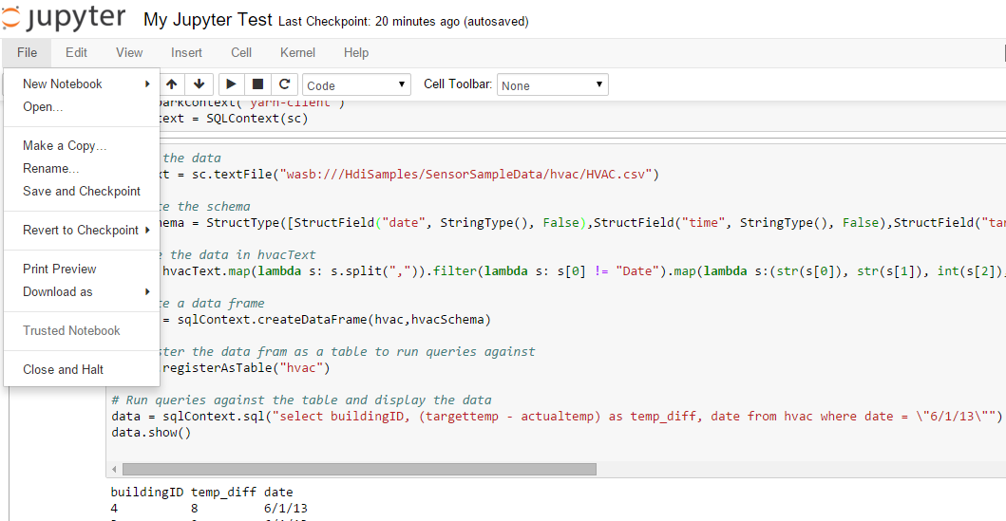
Notes:
Objective: This concludes the Jupyter notebook demo.
Instructions:
You need to make sure that after you have finished running the application, you shut down the notebook to release the resources. To do so, click Close and Halt from the file menu. This will shut down and close the notebook.

Slide 67
Demo
Zeppelin notebook
Notes:
Sources:
What’s Up with Spark – Jupyter and Zeppelin Notebooks (Channel 9)
https://channel9.msdn.com/Series/Azure-Data-Lake/Whats-up-with-Spark35-Jupyter-and-Zepplein-Notebooks
Microsoft Azure – Use Zeppelin notebooks with Spark cluster on HDInsight: Install Zeppelin as part of cluster creation
https://azure.microsoft.com/en-us/documentation/articles/hdinsight-apache-spark-use-zeppelin-notebook/
Microsoft Azure – Use Zeppelin notebooks with Spark cluster on HDInsight: Set up SSH tunneling to access a Zeppelin notebook
https://azure.microsoft.com/en-us/documentation/articles/hdinsight-apache-spark-use-zeppelin-notebook/
Microsoft Azure – Use Zeppelin notebooks with Spark cluster on HDInsight: Accessing the Zeppelin notebook
https://azure.microsoft.com/en-us/documentation/articles/hdinsight-apache-spark-use-zeppelin-notebook/

Slide 68
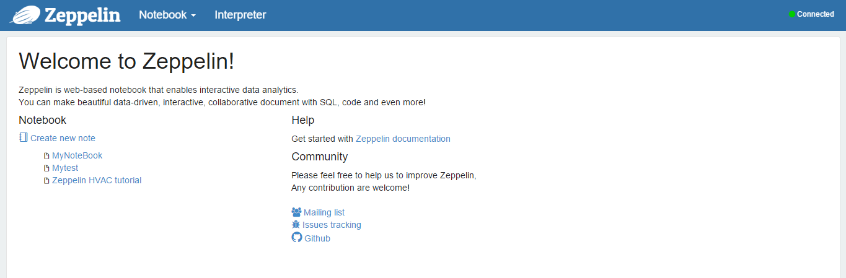
Notes:
Overview: This slide begins the Zeppelin notebook demo.
Instructions:
After you have created a Spark cluster on HDInsight, you can use a web-based Zeppelin notebook to run Spark SQL interactive queries against the Spark HDInsight cluster.
Using this interface you can create a new notebook. The important thing to notice here is that the Connected status in the top-right corner has a green circle. Green means that the Zeppelin front end is successfully connected with the back-end Spark master.

Slide 69
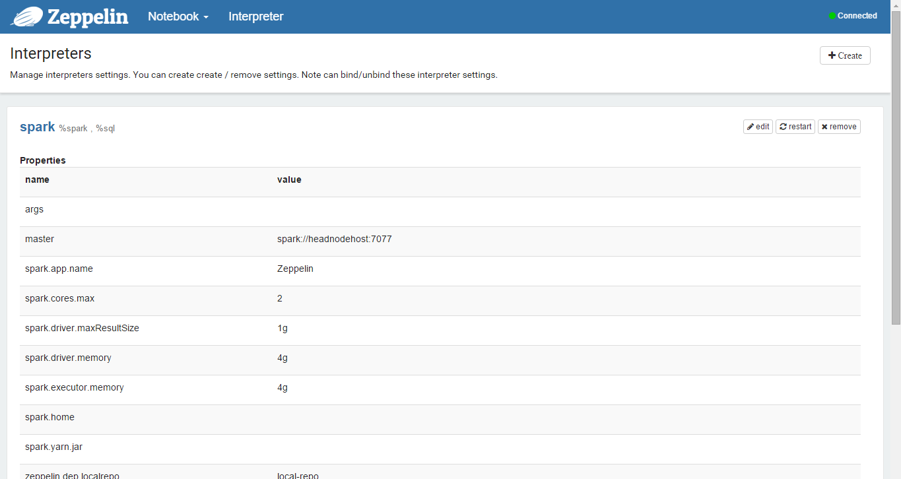
Spark, Cassandra, Hive, and SQL
Notes:
Overview: This slide continues the Zeppelin notebook demo.
Instructions:
The second thing we need to focus on is the Interpreter tab. The Interpreter tab contains standalone pieces of code that allow Zeppelin to talk to the back end and abstract out the code. There are many interpreter types—Spark, Cassandra , Hive, and SQL.
If you look at the Spark type, it defines how the Spark master talks to the Spark cluster. You can view the direct connection to the Spark master on screen.
This all comes pre-loaded, with the interpreter settings pre-configured—though you can change or modify any of interpreter settings per your requirements.

Slide 70
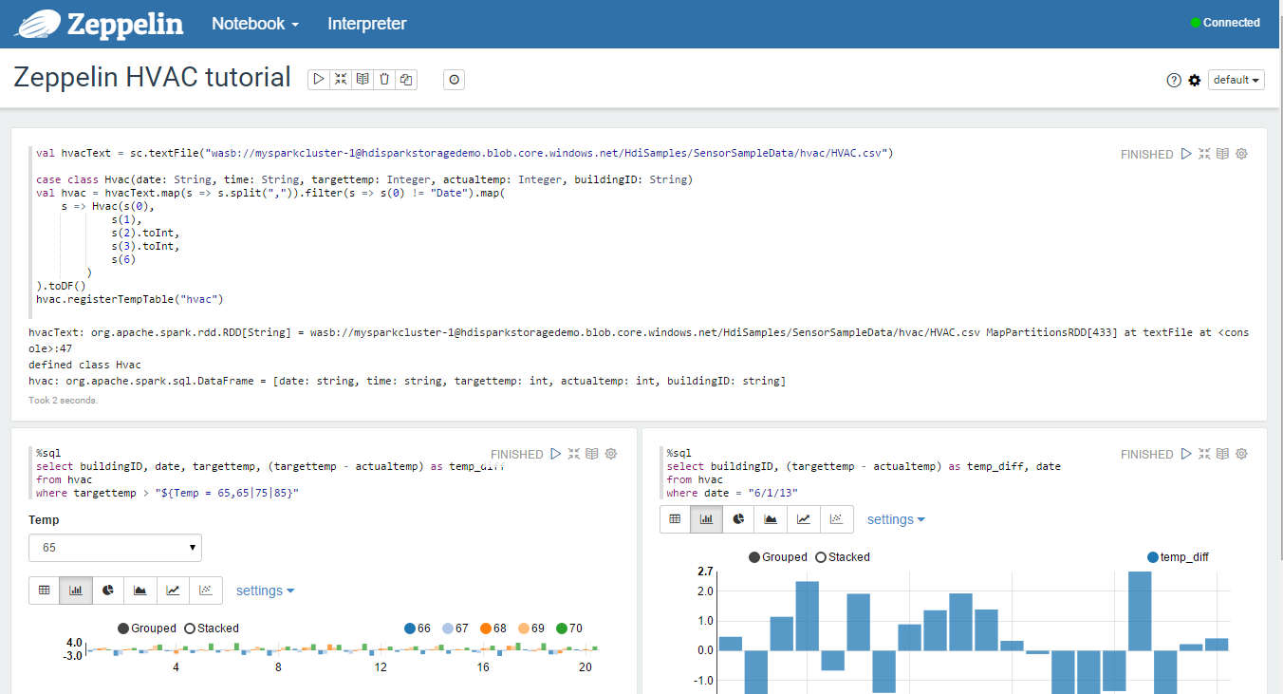
Title
Notes:
Overview: This slide continues the Zeppelin notebook demo.
Instructions:
Now let’s walkthrough the sample here. In this sample we have one Internet of Things (IoT) company that sells the building temperature sensors data. In this screen, you can see the full concept of the notebook, which is divided into few sections.
We have its title.
We can create and reproduce queries, data pipelines and data visualizations.

Slide 71
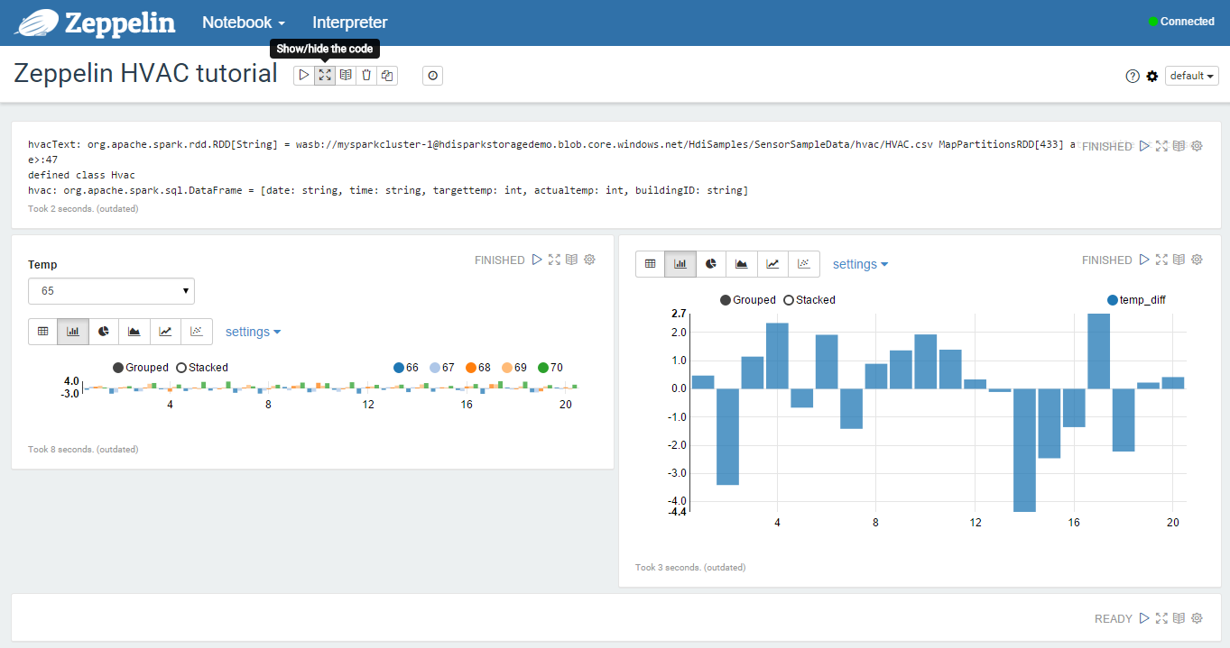
Notes:
Overview: This slide continues the Zeppelin notebook demo.
Instructions:
We can condense the code, but we can only see the responses if you don’t want to show the code—only the output and the reports.

Slide 72
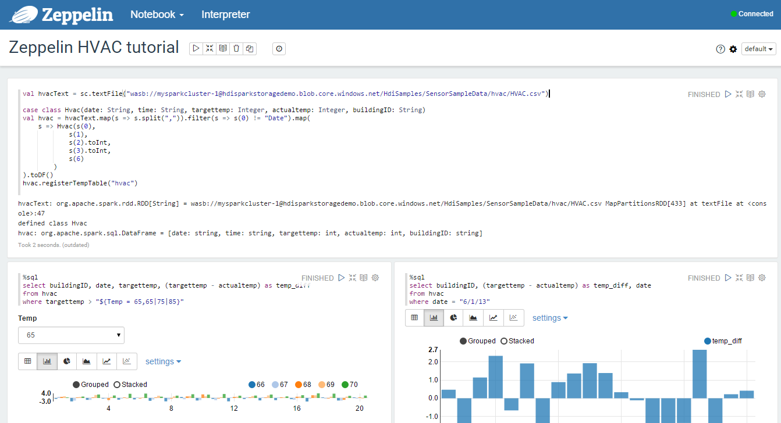
Notes:
Overview: This slide continues the Zeppelin notebook demo.
Instructions:
You can create the number of cells or statement. In this example we have the Scala programming language. Each of the cells has the statement that will be run after another sequentially. You can spread all of these statements into the individual cell or you can group them into one cell.
In the schema, we have:
Date-time stamp
Actual temperature (temperature of the room where the sensor is installed)
Building reference (building location)
Target temperature (what the temperature should be based on statistics)
We are creating a table called HVAC, while waiting for the data from the Azure Storage directly from this CSV file

Slide 73
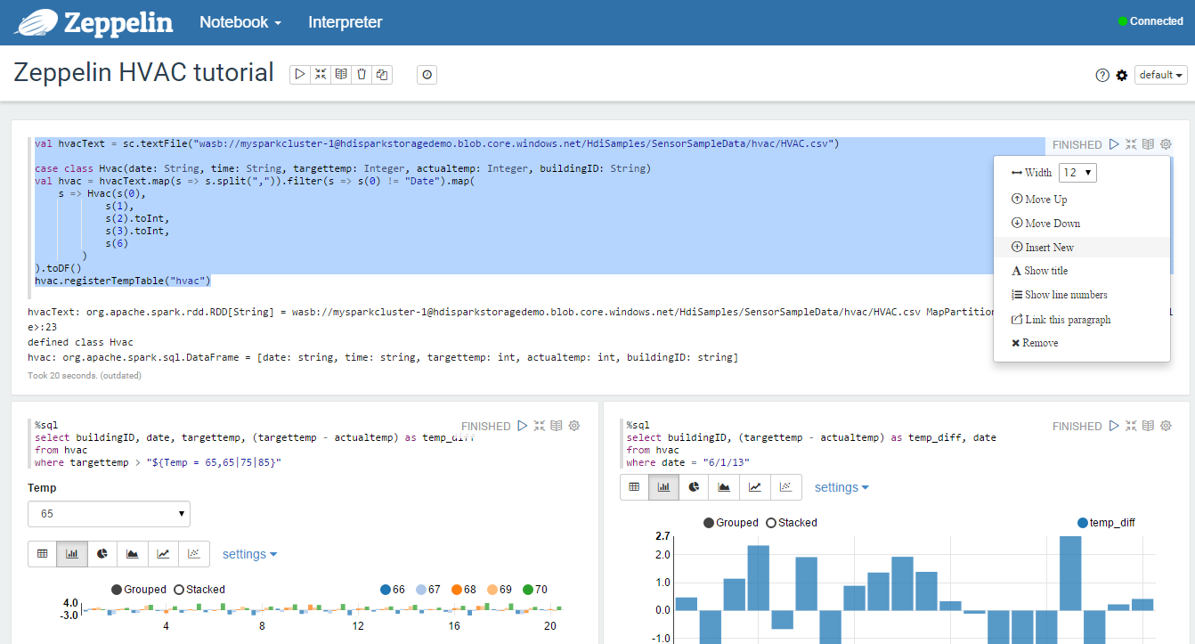
Notes:
Overview: This slide continues the Zeppelin notebook demo.
Instructions:
While it’s running, we will insert a new cell, entering the term % SQL.

Slide 74
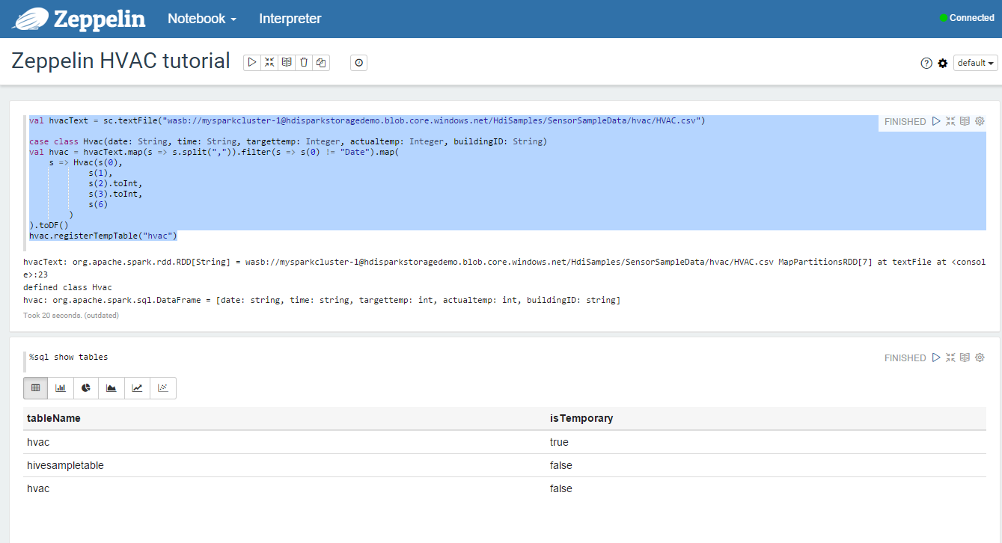
Notes:
Overview: This slide continues the Zeppelin notebook demo.
Instructions:
The running code will create a table called HVAC. To get the result with Zeppelin, we can use a simple SQL statement, as opposed to Scala programming language since we have a SQL interpreter to serve that purpose.

Slide 75
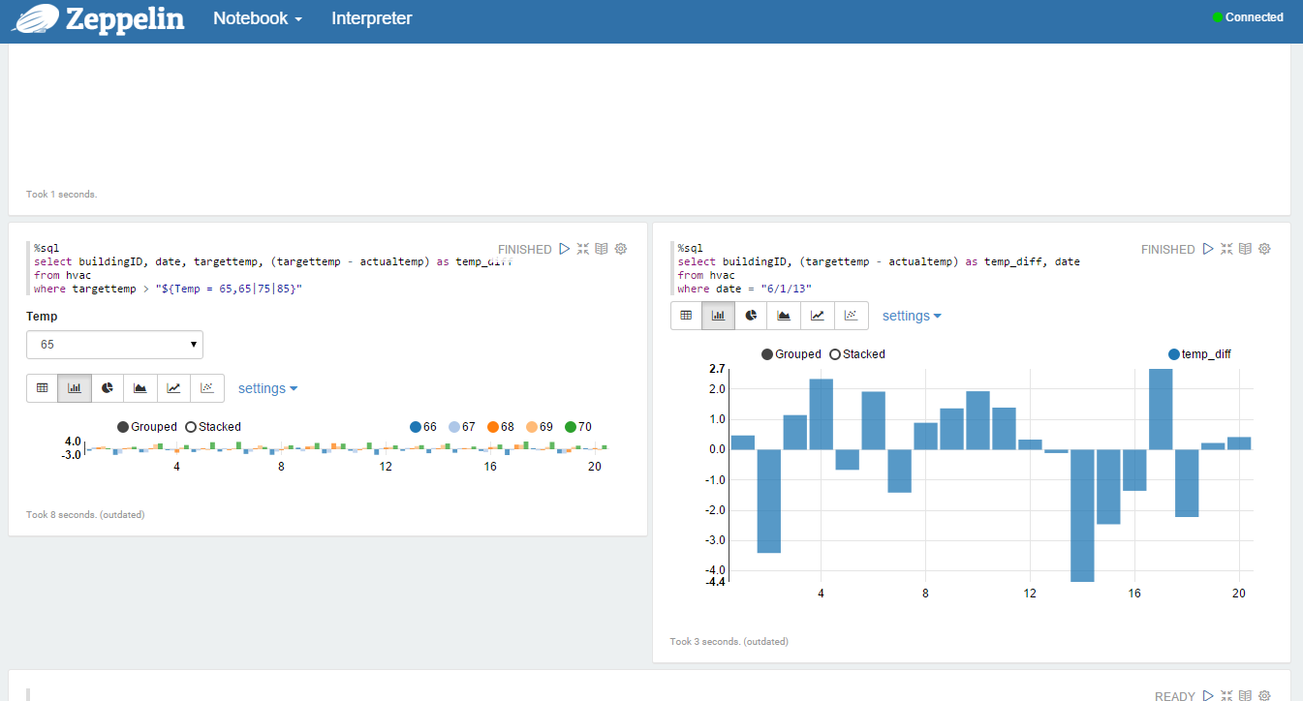
Notes:
Overview: This slide continues the Zeppelin notebook demo.
Instructions:
Notice the results are automatically saved in the cache, making it unnecessary to rewrite or rerun. This means you can still work in this when not connected to the back-end data.

Slide 76

Notes:
Overview: This slide continues the Zeppelin notebook demo.
Instructions:
Next, let’s look at the active farm discipline. In the code we can change the temperature input without modifying the code. Use the $ sign to create a variable input and run Spark SQL statements using variables in the query.
You can also create the sequence of values as input. In this example, it shows how to define a variable, Temp, in the query with the possible values that the user can query or select from the list. When first running the query, a drop-down menu is automatically populated with the values you specified for the variable.
This is a great way that Data Analyst can populate this notebook with possible interactive guidance as input values.

Slide 77
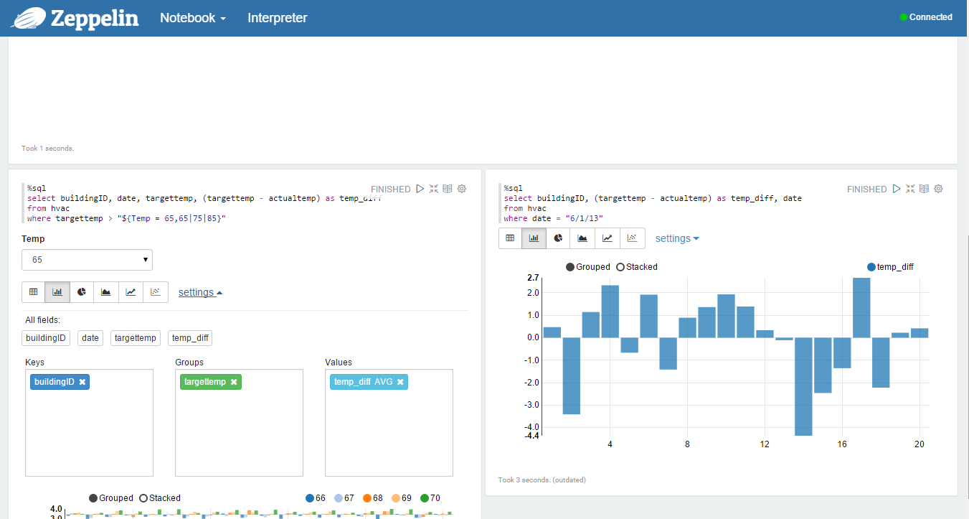
Notes:
Overview: This slide concludes the Zeppelin notebook demo.
Instructions:
You can also the change setting of the graph. Click Settings to choose what constitutes the key and values in the output. The screen capture above uses buildingID as the key, the average of temp diff as the value, and targettemp as the group.

Slide 78
© 2016 Microsoft Corporation. All rights reserved. Microsoft, Windows, Windows Vista and other product names are or may be registered trademarks and/or trademarks in the U.S. and/or other countries.
The information herein is for informational purposes only and represents the current view of Microsoft Corporation as of the date of this presentation. Because Microsoft must respond to changing market conditions, it should not be interpreted to be a commitment on the part of Microsoft, and Microsoft cannot guarantee the accuracy of any information provided after the date of this presentation. MICROSOFT MAKES NO WARRANTIES, EXPRESS, IMPLIED OR STATUTORY, AS TO THE INFORMATION IN THIS PRESENTATION.

